Slide 1
General announcements

Slide 2
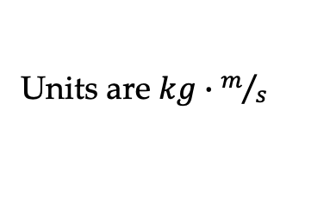

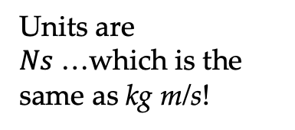


Reminders about impulse and momentum
Moving objects, in addition to having KE, also have momentum
If your momentum changes…
  you’ve probably changed your velocity – you’ve accelerated! This requires a force applied for a certain amount of time.
The quantity is known as impulse. Putting these together:
$$\vec{p}=m\vec{v}$$
Units are $kg∙m/s$
$$\vec{F}∆t$$
$$\vec{F}∆t=∆\vec{p}$$
Units are $Ns$…which is the same as kg m/s!
This quantity is known as impulse.
An impulse causes a change in momentum.

Slide 3
Impulse lab (L-12a)
Go to the class Website and read the lab.
  Note that you will need to mass your cart; you will need to use the integrate function in Logger Pro to determine impulse from your F vs t graph; you will need to use a regression line on your position versus time graph to get your cart’s initial and final velocities. Be sure to print the graphs!
  Be sure you don’t lose the hook that goes with the Force Transducer

Slide 4
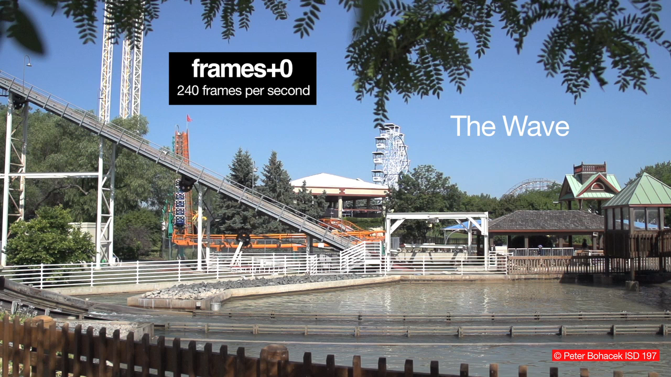
“The Wave”
A rollercoaster car at the bottom of a hill splashing into water. Using the information given in the video, determine the average force the water exerts on the car.

